Slide 1
Allen-Bradley PLCs and EPICS
Kay Kasemir
Oct. 2021

Slide 2
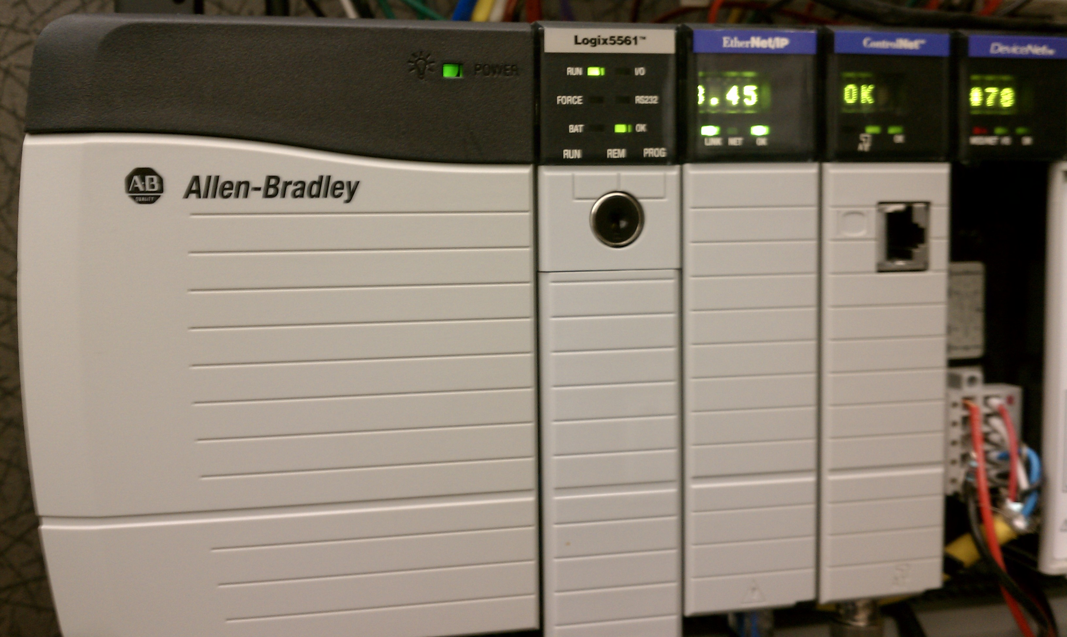
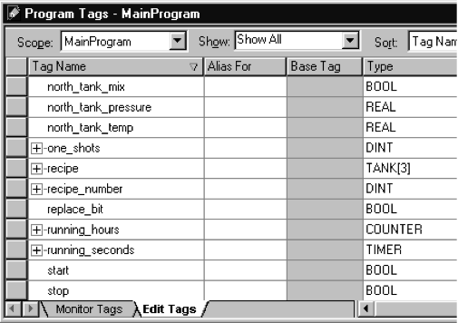
Allen Bradley Control Logix Series
Controller
ENET
PLC
Controller
  Ladder Logic
  or structured text, …
  Named tags
  Not ‘binary table, offset 62’
Ethernet Module
  ‘Industry standard’
  Combined w/ Controller
  in recent models

Slide 3

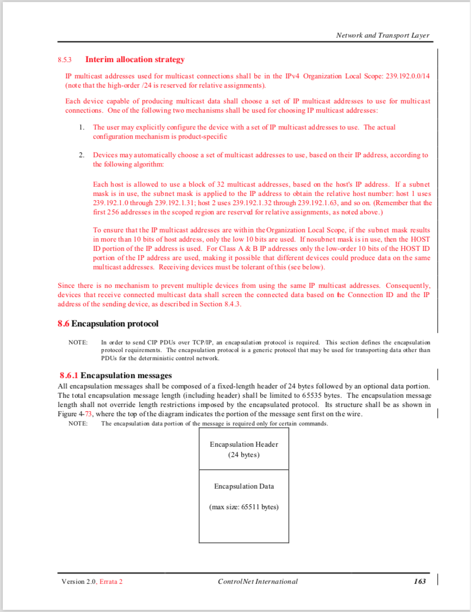
Network Protocol
‘Control Net Over Ethernet”
  TCP encapsulation of CIP
  (Control & Information Protocol)
ODVA Control Net Spec
  How to send message
  Read serial number of ENET module
  How to send/receive CIP via TCP
.. but how to read tags?

Slide 4
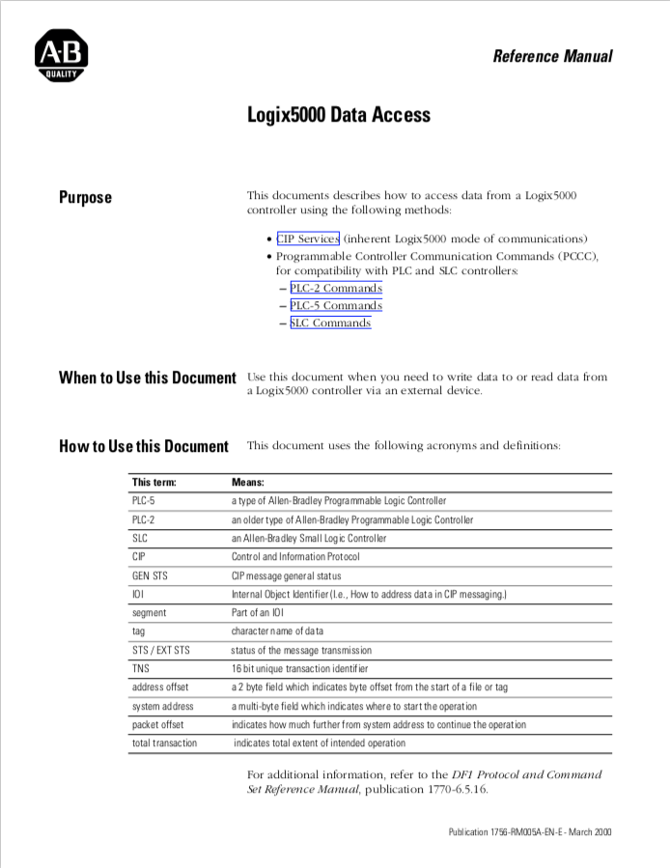
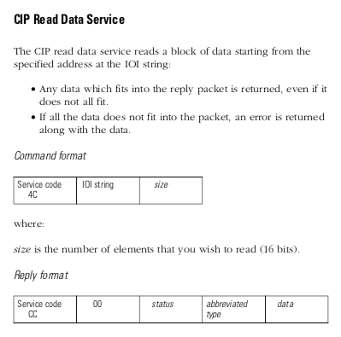
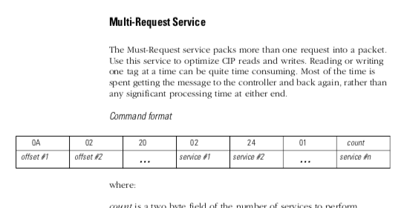
Allen Bradley Network Protocol
1756-RM005A-EN-E.pdf
  Read tag
  Write tag
  Combine commands

Slide 5

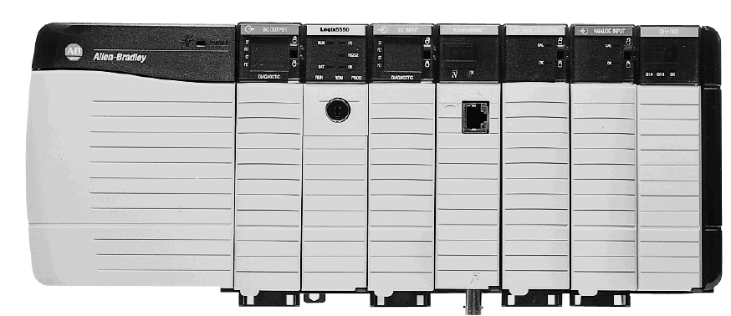
EPICS “Ether IP” Support
Developed ~2000 for SNS
  Key to its operation: Vacuum, cryo, water, …
  Now used by many EPICS sites
Convenient
  Compared to serial, ControlNet, …:
  No special interface hardware nor wiring
  Can read/write any controller tag on the PLC,
  no “publish” required
  “Fast enough”
Supports AllenBradley ControlLogix, CompactLogix
https://controlssoftware.sns.ornl.gov/etherip/
Controller in slot 1

Slide 6
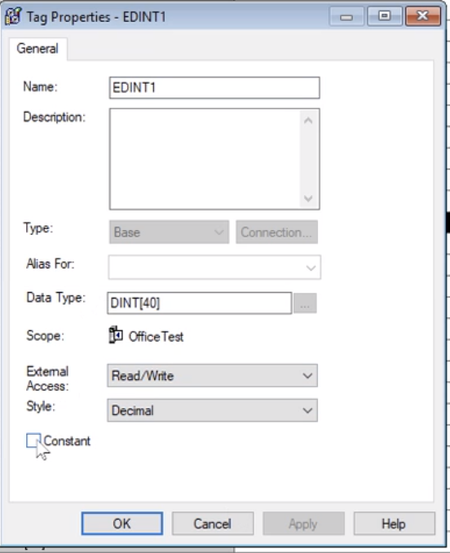
PLC Requirements
ENET Module,
IP 10.1.2.47
ENET Module
  .. Or new CPU with built-in ENET
  Know the IP address
  Know the CPU slot number
    One PLC could have multiple controllers!
Tags
  Know tag names
  “Controller” level,
  not! private to program
  No need to “produce”
  but new versions may require allowing
  “External Access”
Controller,
Slot 0

Slide 7
Demo Setup
These examples assume that a PLC with tags as shown in the following slides is accessible on the network.

Slide 8
Example PLC
ENET IP: 160.91.233.45
Controller in slot 0

Slide 9
Basic Protocol Test
$ ether_ip_test -h
Usage: ether_ip_test <flags> [tag]
Options:
-v verbosity
-i ip (as 123.456.789.001 or DNS name)
-p port
-s PLC slot in ControlLogix crate (default: 0)
-t timeout (ms)
-a array size
-w <double value to write>

Slide 10
Protocol Tests
﻿# Read changing number (call a few times to see changes)
ether_ip_test -i 160.91.233.45 PR1
# Same, but whole array (compare time to single element read)
ether_ip_test -i 160.91.233.45 -a 40 PR1
# Try reading too much
ether_ip_test -i 160.91.233.45 -a 41 PR1
# Show protocol details
ether_ip_test -v 10 -i 160.91.233.45 PR1
# Write array elements, then read whole array
ether_ip_test -i 160.91.233.45 -w 40 ER1[1]
ether_ip_test -i 160.91.233.45 -w 42 ER1[2]
ether_ip_test -i 160.91.233.45 -a 40 ER1

Slide 11
EPICS Records
﻿# Run like this:
# eipIoc -p my_plc=160.91.233.45 -d plc.db
record(ai, "number1")
{
field(DTYP, "EtherIP")
field(INP, "@my_plc PR1[0]")
field(SCAN, "1 second")
}
In IOC console:
help
dbl
dbpr number1
﻿drvEtherIP_dump
﻿drvEtherIP_report 10
EIP_verbosity 10
In other terminal:
camonitor number1
See also VM in /ics/examples/15_plc

Slide 12
Starting the IOC: Development
‘softIoc’ with EtherIP built in
Type this on one line:
eipIoc
-p my_plc=10.1.2.47
–m "P=MyPrefix,N=2"
–d example.db
-p "name=ip,slot"
Define PLC name for “@my_plc” in INP/OUT links,
IP address, optional CPU slot
-m "macro=value"
Define database macros
-d path/to/some.db
Load database

Slide 13
EPICS Records
Input Records (ai, bi, mbbi, mbbiDirect, stringin)
field(DTYP, "EtherIP")
field(INP, "@my_plc name_of_tag")
field(SCAN, "1 second”)
Output Records (ao, bo, mbbo, mbboDirect)
field(DTYP, "EtherIP")
field(OUT, "@my_plc name_of_tag")
Need to be familiar with EPICS Records,
https://epics.anl.gov/base/R7-0/4-docs/RecordReference.html

Slide 14
Tools on IOC
drvEtherIP_dump
  Dumps all tags and their value
drvEtherIP_report level
  Dumps info about each plc, period list, tag
  Level 0..10
Set records’ TPRO field
  Show when tag is read/written by that record
EIP_verbosity(7), EIP_verbosity(10)
  Show warnings or details of protocol

Slide 15
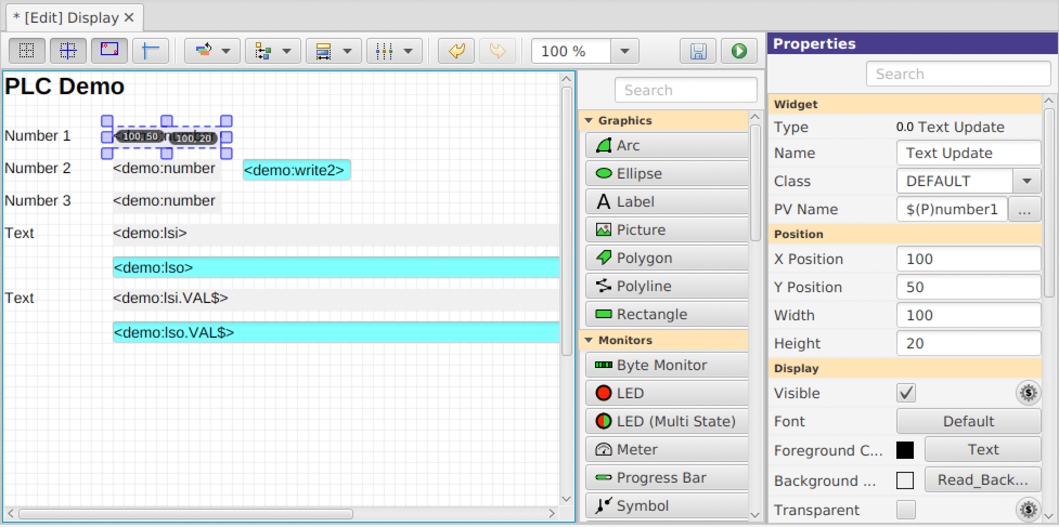

Display (CS-Studio)
Start ‘css’
Use menu ‘Applications’,
‘Display’,
‘New Display’,
enter file name
Select ‘Text Update’
from ‘Monitors’
Enter ‘PV Name’
Click ‘Run’ button
➔ Does the number show up as expected?
Actual value: 3.5 ?!

Slide 16
Driver Combines Tags used by Records
plc2.db
Records
  INP “@plc1 arrayA[2]”, SCAN “2 second”
  INP “@plc1 arrayA[3]”, SCAN “2 second”
  INP “@plc1 arrayB[13]”, SCAN “1 second”
  INP “@plc2 arrayA[2]”, SCAN “2 second”
Driver
“plc1”
  Handle “arrayA[0-3]” every 2 seconds
  Handle “arrayB[0-13]” every 1 second
“plc2”
  Handle “arrayA[0-2]” every 2 seconds

Slide 17
Scan Flag “ S <seconds>”
Records
  INP “@plc array[2]”, SCAN “2 second”
  INP “@plc array[3]”, SCAN “1 second”
  INP “@plc array[13]”, SCAN “I/O Intr”
  OUT “@plc array[5]”, SCAN “Passive”
Driver
  Uses the “fastest” SCAN of any record related to a tag.
  Records 2 & 3 should add “@plc array[..] S 1” to provide suggested scan period, otherwise warning
  “cannot decode SCAN field, no scan flag given”

Slide 18
PLC Data Type ⬄ Record Type
REAL, INT, DINT ⬄ ai, ao (REAL? VAL, else RVAL)
INT, DINT, BOOL[] ⬄ bi, bo, mbbi, mbbo,
mbbiDirect, mbboDirect
BOOL ⬄ bi, bo
STRING ⬄ stringin, stringout
For arrays, access one element:
field(INP,"@my_plc my_array[42]")
For structures, access one element:
field(INP,"@my_plc gadget.ps.voltage")

Slide 19
Bitfiddly Stuff
plc3.db
Internally, DINT and BOOL[32] look similar.
Driver assumes bit for binary records.
“some_tag[40]”
  ai, ao:
  Element 40 of a REAL, INT, DINT array
  bi, bo, mbb*:
  Bit 40 of a BOOL array,
  or
  bit 40 of a DINT array, i.e. bit 8 of DINT[1]
  To force [i] to be the i^{th} array element, add ‘Bit’ flag: “some_tag[1] B 8”

Slide 20
Reading, Writing, Scanning
Records
  INP “@plc array[2]”, SCAN “2 second”
  INP “@plc array[3]”, SCAN “1 second”
  INP “@plc array[13]”, SCAN “I/O Intr”
  OUT “@plc array[5]”, SCAN “Passive”
Driver
  “array[0-13]” read every 1 second
  Reads most recent value[2] every 2 seconds
  .. [3] every 1 second, data may be 0.999 sec old
  Processes whenever value [13] changes
  Reads (though output!). Checks if value [5] changes.
  When processed, updates value [5], marks whole tag for writing. Driver will then once write instead of read.

Slide 21
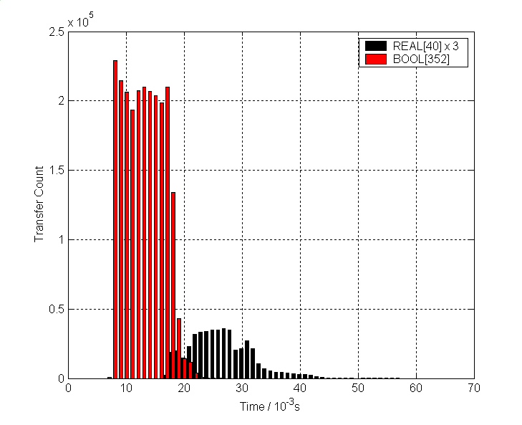
Transfer Time Histogram
352 BI @ 10Hz, 3 x REAL[40] @ 2 Hz

Slide 22
Arrays, Aliases
Arrays are MUCH more effective
  Read scalar REAL tag: 10..30ms
  Read REAL[40]: 10..30ms
  Read BOOL[352]: 10..30ms
  Read 352 separate BOOL tags: ~352 * (10..30) ms
Records with INP or OUT that access
  INP=“@plc my_array[2]”
  INP=“@plc my_array[39]”
  Driver reads my_array[0..39]
Arrange data in array tags
Configure INP/OUT to use array elements
May use alias tags within PLC logic,
or designated read-inputs, write-outputs tasks at start/end of your ladder logic
!

Slide 23
Write vs. Read Arrays
“Output” records read
  Just in case somebody else (PanelView, other IOC) changes tag
Writing one or more array elements means writing whole array
  Gets confusing when both PLC and IOC update elements in same array
Arrange data in array tags
Use separate arrays for ‘IOC reads’ and ‘IOC writes’
Configure INP/OUT to use array elements
May use alias tags within PLC logic
!

Slide 24
The Elusive Buffer Limit
Driver combines several reads and writes for tags into one network transfer until either the request or the response reaches EIP_buffer_limit
How large?
About 500 bytes, details fuzzy
Set too large
  → PLC error “Buffer too small, partial data only”
Set too small
  → Inefficient, can’t combine many tags
Set way too small
  →Can’t read a single REAL[40] array, driver error
  “Tag ‘xyz’ exceeds buffer limit of .. Bytes”
Don’t mess with the default EIP_buffer_limit.
Keep arrays to REAL/DINT/INT[40] and BOOL[400]. Driver will then combine several of those in one transfer.

Slide 25
Elementary “ E” Flag
Records
  INP “@plc array[190]”
  OUT “@plc array[191]”
Driver
  Reads array[0..191], but we may only use [190], [191]
  ➔
  “@plc array[190] E“ causes transfer of just that array element
  Writes all of [0..191] even if just 191 was changed, writing elements which we otherwise wanted to read
    Use separate arrays for “writing” and “reading”
    Add “ E” to write just that element, not whole array

Slide 26
Summary
Arrange PLC data in arrays
  Alias tags to document PLC logic
  Separate arrays for reading, writing
  Use about 40 elements per array (400 for BOOL)
Point records’ INP/OUT to those array tags
Create display (CS-Studio, EDM, …)
Done

Slide 28
Starting the IOC: Production Setup
Add driver to ‘makeBaseApp’ type IOC:
configure/RELEASE:
ETHER_IP=/path/to/share/ether_ip
yourApp/src/Makefile:
your_DBD += ether_ip.dbd
your_LIBS += ether_ip
iocBoot/iocYours/st.cmd:
drvEtherIP_init()
drvEtherIP_define_PLC("my_plc", "10.1.2.47", 0)
dbLoadRecords(…

Slide 29
Assume you have…
3 vacuum PLCs, basically the same ladder logic and tags, but for different sectors of the machine
Database split for convenience into two files
  Using macros “$(PLC)” to select PLC
  and “$(S)” for start of record names
Sector 1 Vacuum PLC
Sector 2 Vacuum PLC
Sector 3 Vacuum PLC
vac_analogs.db
vac_binaries.db

Slide 30
Option 1: One IOC per PLC
Vac IOC 1
PLC=plc1, S=Vac1
Sector 1 Vacuum PLC
vac_analogs.db
vac_binaries.db
Vac IOC 2
PLC=plc2, S=Vac2
Sector 2 Vacuum PLC
vac_analogs.db
vac_binaries.db
Vac IOC 3
PLC=plc3, S=Vac3
Sector 3 Vacuum PLC
vac_analogs.db
vac_binaries.db

Slide 31
Option 2: One IOC for all PLCs
Vac IOC
PLC=plc1, S=Vac1
PLC=plc2, S=Vac2
PLC=plc3, S=Vac3
Sector 1 Vacuum PLC
vac_analogs.db
vac_binaries.db
Sector 2 Vacuum PLC
vac_analogs.db
vac_binaries.db
Sector 3 Vacuum PLC
vac_analogs.db
vac_binaries.db

Slide 32
Option 3: One IOC for analogs, one for binaries
Vac IOC 1
PLC=plc1, S=Vac1
PLC=plc2, S=Vac2
PLC=plc3, S=Vac3
Vac IOC 2
PLC=plc1, S=Vac1
PLC=plc2, S=Vac2
PLC=plc3, S=Vac3
vac_analogs.db
Sector 1 Vacuum PLC
vac_binaries.db
vac_analogs.db
Sector 2 Vacuum PLC
vac_binaries.db
vac_analogs.db
Sector 3 Vacuum PLC
vac_binaries.db

Slide 33
 | Pro | Con | Verdict
One IOC per PLC | Can reboot IOC for one sector and still operate other sectors’ vacuum | More IOCs to maintain. Top-level vacuum display needs to connect to 3 IOCs. | May be necessary if single IOC gets too busy.
One IOC for all PLCs | Fewer IOCs to maintain. Top-level vacuum display can get all data from one IOC. | Reboot or problem of IOC will interrupt all vacuum access. | Simple and good, especially to get started.
One IOC for analogs, another for binaries | ?? | Each PLC has multiple IOC connections. Vacuum displays need multiple IOC connections. | Don’t

